Slide 1
Containment of Candida auris
Tabletop Exercise
Background

Slide 2
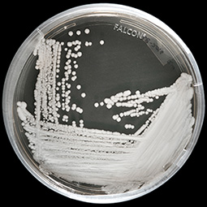
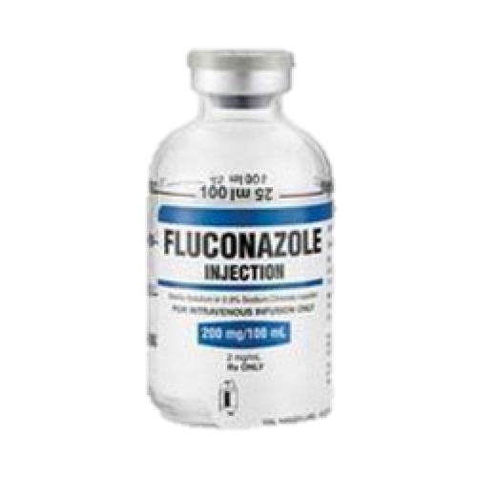
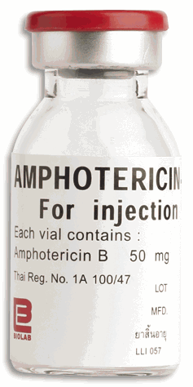
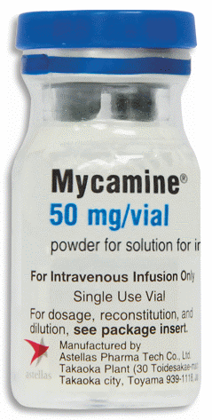
Why Is C. auris A Problem?
It causes serious infections
Antifungal resistance
Requires disinfection with sporicidal agent
Persistent colonization
Persistence in environment
Healthcare-associated outbreaks
Lab misidentification
https://www.cdc.gov/fungal/candida-auris/candida-auris-qanda.html

Slide 3


Patients Are Colonized With C. auris
Skin >>> gut
Long-term colonization (months→indefinitely)
Colonization poses risk for:
  Invasive infection
  Transmission to others
Thrives in “warm, salty” places
  Axilla, groin → sites for colonization screening
Notes:
Identify colonized individuals before infections; UK
No readily available methods like there are for MRSA and CRE
Complex microbial communities only want C. auris

Slide 4
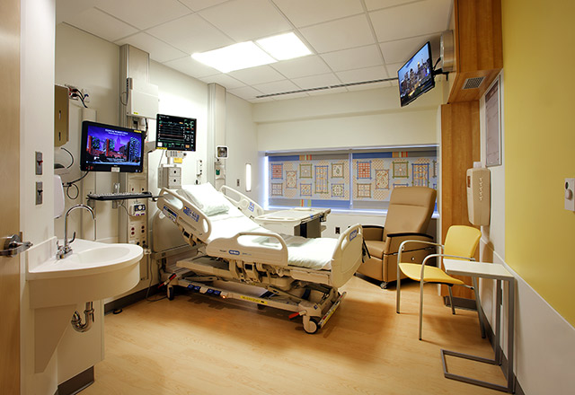
C. auris can Persist in the Hospital Environment
Notes:
We also sampled the rooms of these 5 case-patients and found C. auris on multiple surfaces.
(click) Bed rail or mattress was the most common site, followed by (click) window-sill; C. auris was also found on an (click) infusion pump, (click) a chair, and (click) a counter-top.
No samples were positive after rooms were cleaned with bleach. Collaboration with DHQP

Slide 5
Not Susceptible To Usual Quaternary Ammonium
Disinfectants Used In Hospitals
Low log reduction for C. auris compared to MRSA
Cadnum et al. 2017
Notes:
Start with quats

Slide 6
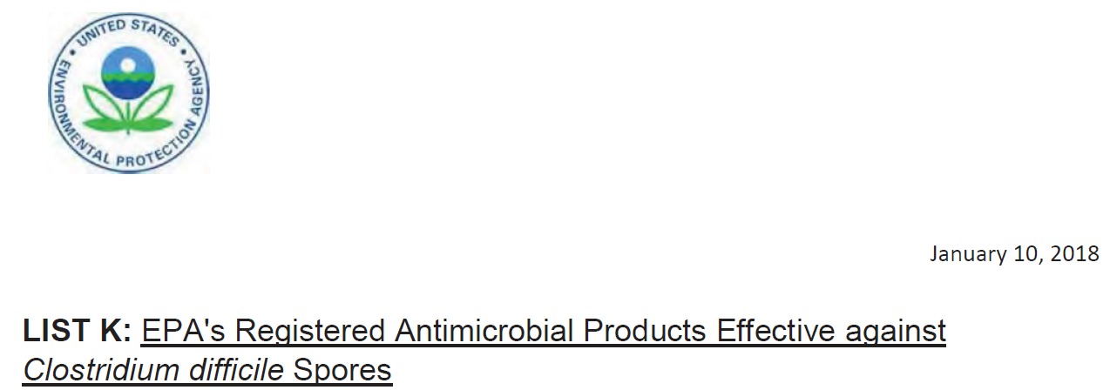
Environmental Cleaning
Product and Practice!
Sporicidal product
Contact time
Elbow grease
Surface must be in contact
  who is responsible for cleaning?
https://www.epa.gov/pesticide-registration/list-k-epas-registered-antimicrobial-products-effective-against-clostridium

Slide 7

United Kingdom Outbreak in ICU
C. auris outbreak in UK hospital
9 C. auris bloodstream infections
>40 people colonized
Clear patient-to-patient transmission

Slide 8
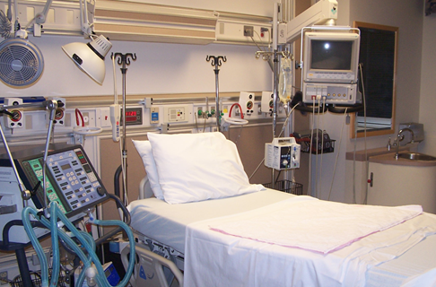
Beastly To Control
Contact precautions
Screening for colonization
Chlorhexidine bathing
Cleaning room with bleach 3X/day
Terminal cleaning with higher concentration bleach
Eventually closed unit
C. auris cultured from many surfaces

Slide 9
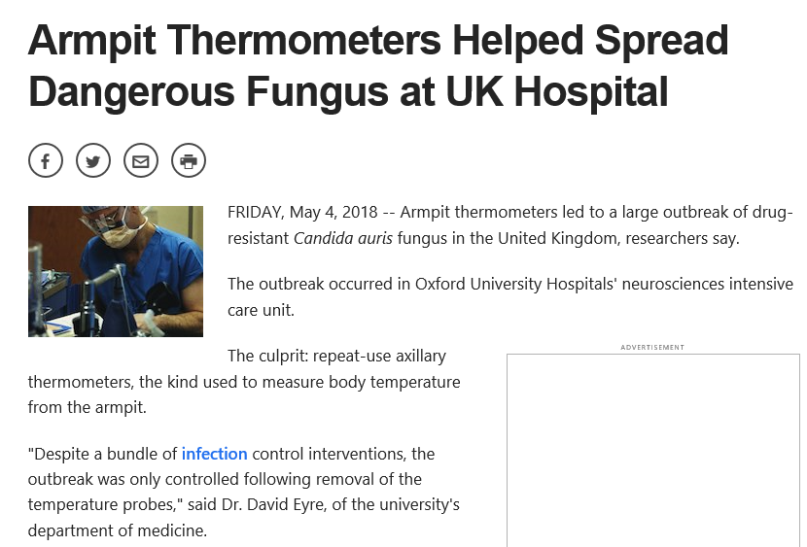
Dedicated Equipment!

Slide 10
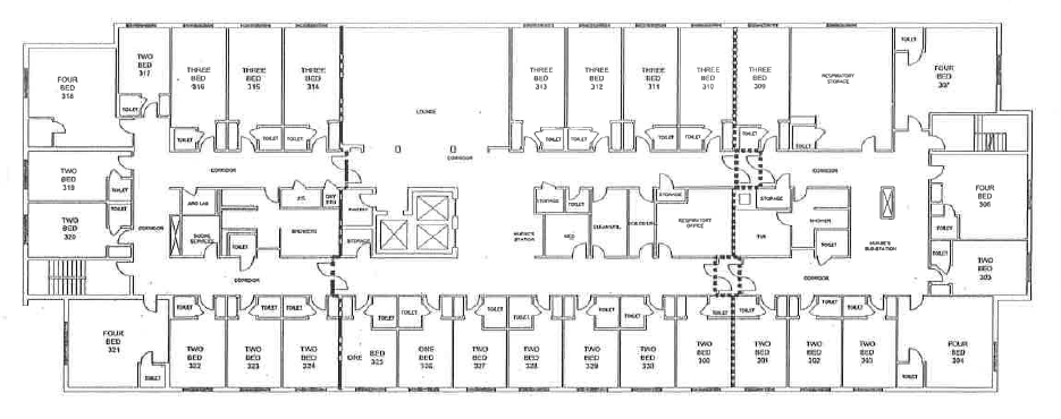
vSNF A Vent-Floor
March 2017 C. auris Prevalence
Prevalence=1.5% (1/69)
C. auris positive (1)
Screened negative for C. auris (65)
Not tested for C. auris (refused or not in room) (3)
PPS # 1
Slides courtesy of M. Pacilli-Chicago Department of Public Health

Slide 11
vSNF A Vent-Floor
1/30/18 C. auris Prevalence
Prevalence=43% (29/67)
C. auris positive (29)
Screened negative for C. auris (33)
Not tested for C. auris (refused or not in room) (5)
PPS # 2

Slide 12
vSNF A Vent-Floor
3/6/18 C. auris Prevalence
Prevalence=59% (39/66)
Screened negative for C. auris (23)
New C. auris positive (16)
Previous C. auris positive (23)
Not tested for C. auris (4)
Room previously held positive patients
PPS # 3

Slide 13
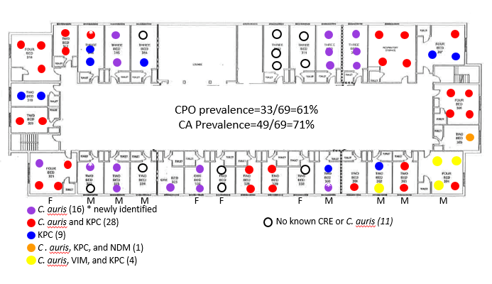
vSNF A Vent-Floor
10/16/2018 MDRO Prevalence
PPS # 8

Slide 14
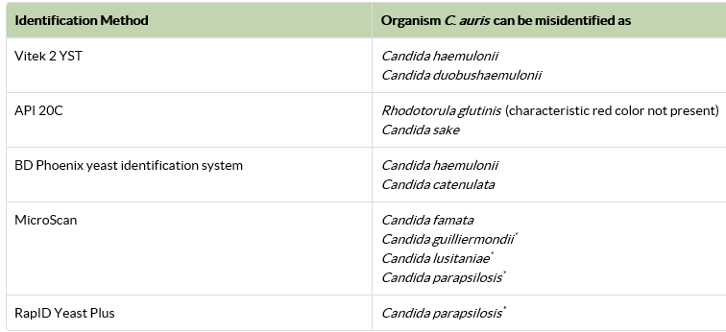
Challenges In Identifying C. auris
Often misidentified
e.g. C. haemulonii
If try to speciate, fail to get an answer
Ask:
What is the identification method used your Laboratory (contract lab)?
What database is being used?
What version of the database is being used?
https://www.cdc.gov/fungal/candida-auris/recommendations.html

Slide 15

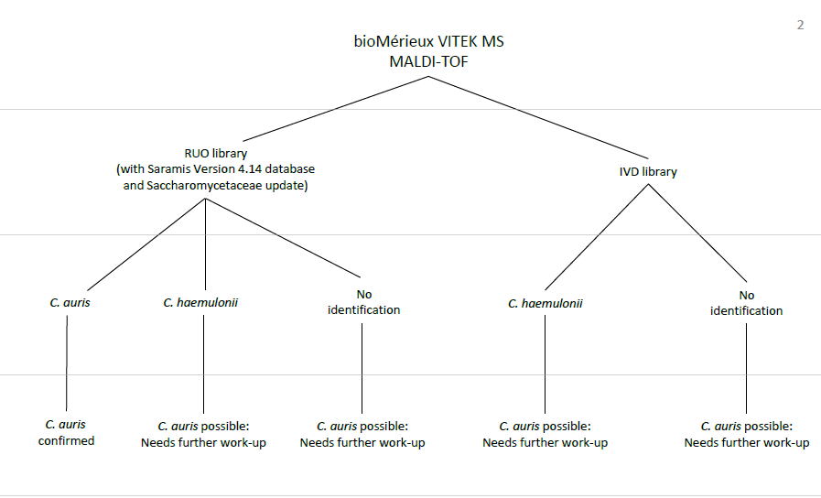
https://www.cdc.gov/fungal/diseases/candidiasis/pdf/Testing-algorithm-by-Method-temp.pdf

Slide 16
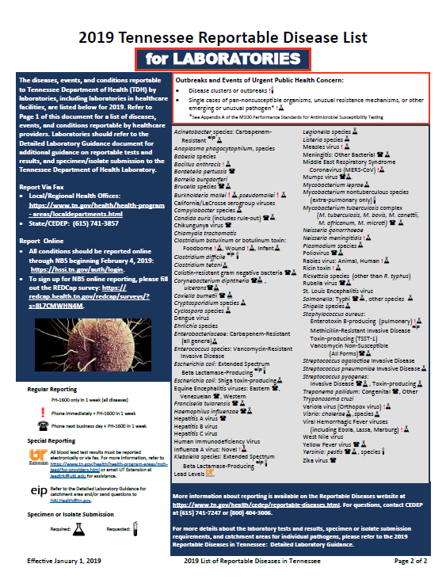
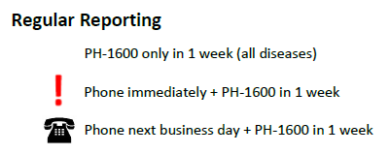
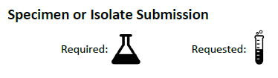
https://www.tn.gov/content/dam/tn/health/documents/reportable-diseases/2019_List_For_Healthcare_Providers.pdf

Slide 17
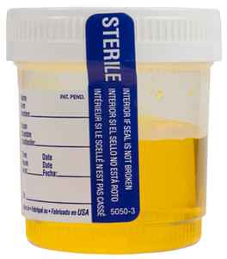
Other Challenges With Detection
40% of clinical cases in the U.S. have been from non-bloodstream isolates (e.g., urine, bile, wounds)
Species from non-sterile isolates often not identified

Slide 18
C. auris clinical cases reported by state — United States, 2013–November 2018
~520 clinical cases
~1420 clinical + screening cases
Solid: Confirmed case Striped: Probable case

Slide 19
Clinical Cases of C. auris Reported in the United States as of November 30, 2018
Number of C. auris clinical cases
0
1
2-10
11-50
51-100
101 or more
Notes:
Clinical cases of C. auris reported in the United States as of November 30, 2018
Clinical cases includes confirmed and probable cases (see CSTE case definitions).
CSTE case definitions hyperlink: http://c.ymcdn.com/sites/www.cste.org/resource/resmgr/2017PS/2017PSFinal/17-ID-03.pdf

Slide 20
Key Concepts
Patients with a history of healthcare in certain countries and/or areas of the U.S. are at increased risk of infection/colonization
Patients can be colonized without active infection
Patients can be colonized indefinitely
  No data on maximum amount of time
  No data on efficacy of decolonization

Slide 21
Key Concepts (cont.)
Candida auris can be misidentified as other Candida species
Candida is often not speciated
Can easily spread and cause outbreaks in healthcare facilities
Can persist in the environment for long periods of time
Common hospital disinfectants (i.e. quaternary ammonium compounds) are not sufficient
  List K: EPA registered disinfectants active against C. diff (sporicidals)
    Ex: bleach
Hand hygiene

Slide 22
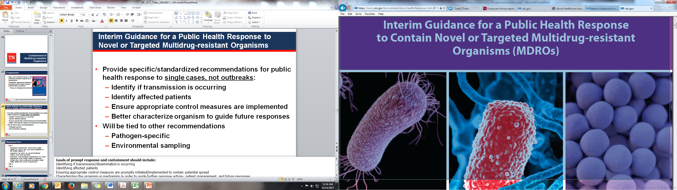
Containment of MDROs
https://www.cdc.gov/hai/outbreaks/docs/Health-Response-Contain-MDRO.pdf
Notes:
I am going to review the 2016 interim guidance to contain novel or targeted multidrug-resistant organisms. I want you to be aware of these containment strategies recently put out last year by the CDC. The overarching goal is to prevent transmission in healthcare settings and prevent these from becoming endemic in our state.

Slide 23
Containment Goals
Slow spread of novel or rare multidrug-resistant organisms or mechanisms
Systematic, aggressive response to single cases of high concern antimicrobial resistance
Focus on stopping transmission
https://www.cdc.gov/hai/outbreaks/docs/Health-Response-Contain-MDRO.pdf

Slide 24
Containment of MDROs (cont.)
Tiered approach for public health response to contain novel or targeted MDROs
  Single cases, not outbreaks, should prompt specialized recommendations:
    Identify if transmission is occurring
    Identify affected patients
    Ensure implementation of aggressive control measures
    Consider environmental sampling depending on pathogen
Notes:
It is a tiered approach or response to a single case of novel organisms. Single cases, rather than outbreaks, should prompt specialized response including identifying whether transmission is occurring, identifying other affected patients, ensuring aggressive control measures and may prompt environmental sampling depending on the pathogen.

Slide 25
Targeted Pathogens for Containment
Examples
Tier 1:
  Candida auris
  Vancomycin-resistant Staphylococcus aureus
  Pan-resistant isolates
Tier 2
  mcr-1 producing Enterobacteriaceae
  Non-KPC CP-CRE (i.e. NDM, VIM, IMP, OXA-48)
  Carbapenamase-producing Pseudomonas sp.
Tier 3
  KPC CP-CRE
Notes:
Examples of targeted pathogens are shown here. These national priorities are now reflected in the state disease reporting rules that are updated annually and now include…

Slide 26
Interventions Depending on Tier
Enhanced infection control
  Hand hygiene
  Transmission-based precautions
  Environmental cleaning
Notify patients, families and providers
Educate healthcare personnel and visitors
Flag patient record
Depending on tier
    Lab look back
    Screening of facility roommates
    Healthcare personnel screening
Notes:
All of these tiers call for enhanced infection control including consistent hand hygiene, transmission-based precautions, notification of patients, families and other healthcare and homecare providers. Healthcare personnel and visitors both need to be educated particularly on the need for meticulous hand hygiene and depending on the setting—helping them understand the need for gloves and gowns etc. Hospital electronic health records should be flagged along with the date as these are known to result in colonization for up to a year. The higher tiers require lab look backs to see if previous patients have been missed who may have been the source. In some circumstances, in consultation with our group, roomates or entire units may be screened and rarely healthcare personnel might be screened.

Slide 27
Tiered Response Following MDRO Detection
 | Tier 1 | Tier 2 | Tier 3
Lab lookback
Prospective surveillance
Healthcare roommate screening
Broader healthcare contact screening
Household contact screening
Environmental sampling
Healthcare personnel screening
Notes:
Those response elements are laid out here in tabular, easy to read form by tier. Please note that at this time, healthcare personnel and environmental sampling are going to be rarely recommended but roommates, other patients on a given unit and potentially household contacts may well be recommended for screening depending on the tier. We want to talk through those decisions with you and Marion will follow in more detail about the resources that are now available to make this happen.

Slide 28
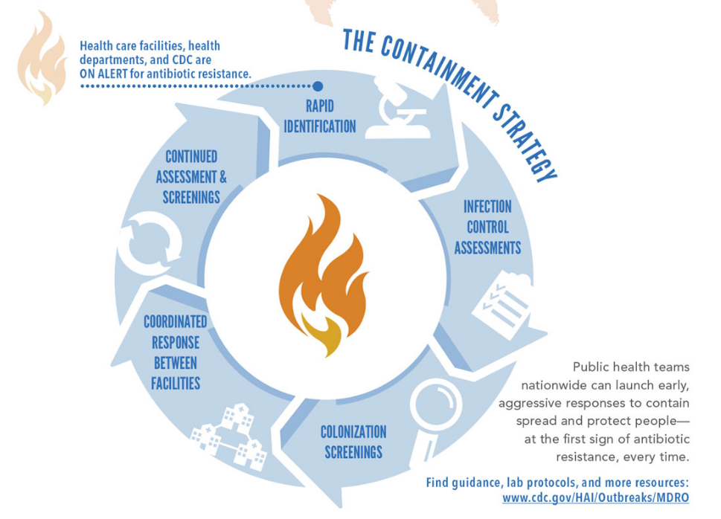
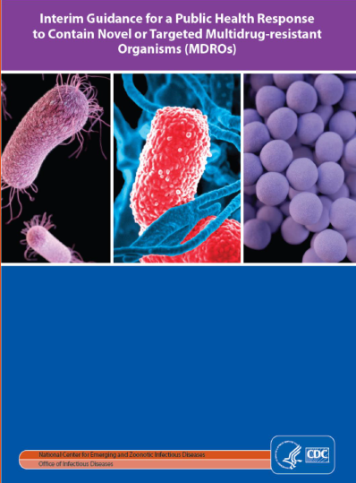
MDRO Containment Strategy
https://www.cdc.gov/hai/outbreaks/docs/Health-Response-Contain-MDRO.pdf

Slide 29
Identify Early
Report Early

Slide 30
Questions to ASK/ Actions:
Have you been outside of the US in last 30 days?
  If so– which countries?
  [Ebola, MERS, Novel/ avian influenza]
Have you been hospitalized or been in a nursing home in the last 12 months outside of the US or in New York City, New Jersey or Chicago?
  Candida auris; CP-CRE, CP-PA
  THEN: Contact precautions, contact PH; colonization screening at ARLN

Slide 31
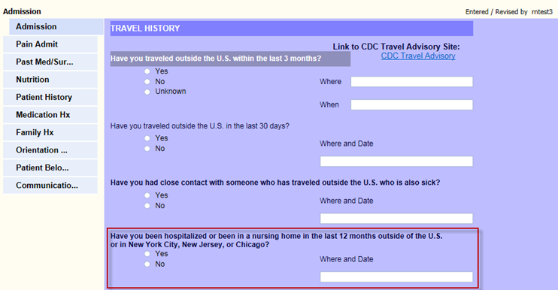
EHR Travel History Example
Courtesy of J. Swift, Ballad Health

Slide 32
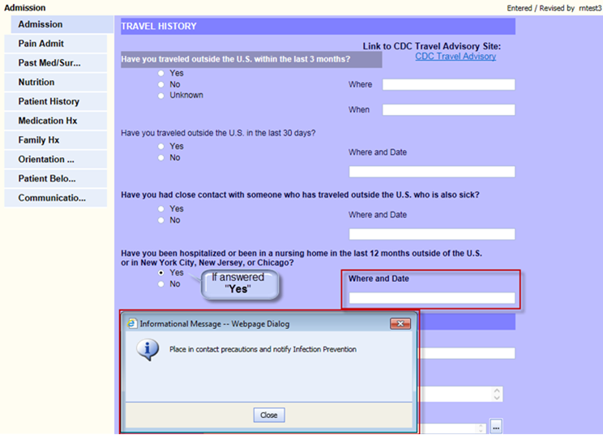
EHR Travel History Example (cont.)
Courtesy of J. Swift, Ballad Health

Slide 33
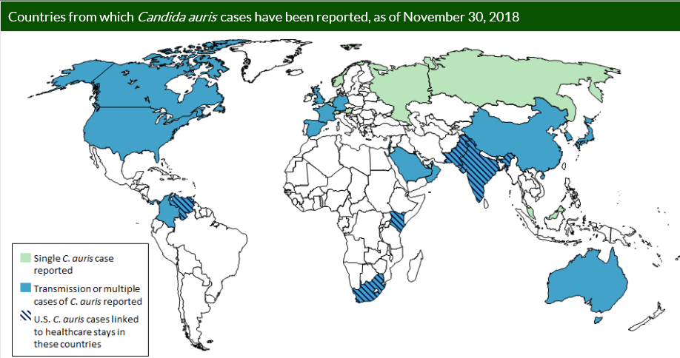

Slide 34
Response Actions
Place patient in single room and institute contact precautions
Reinforce and enhance hand hygiene practices
Institute thorough environmental cleaning and disinfection of the patient care area
Use an EPA-registered disinfectant active against C. diff for routine and terminal disinfection
Implement contact tracing and testing to identify other patients colonized with
C. auris
Retrospective for preceding 1 year and prospective microbiology records review

Slide 35

The Antibiotic Resistance Laboratory Network (ARLN)

Slide 36
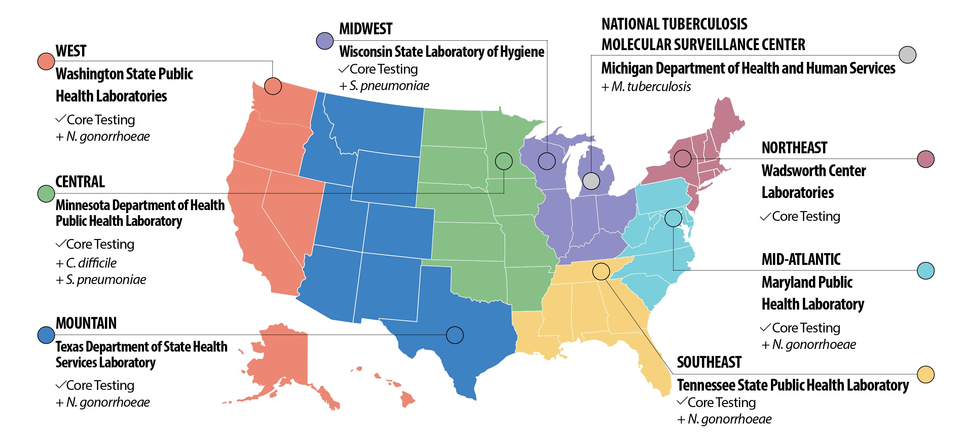

ARLN Regional Laboratories

Slide 37


Colonization Screening — Flow of Specimens & Results
Specimens
PHD
Hospital
State Health Department
Regional Laboratory
Results

Slide 38
MDRO Containment Strategy
https://www.cdc.gov/hai/outbreaks/docs/Health-Response-Contain-MDRO.pdf

